Slide 1

Manchester Raspberry Jam 32
August 2015

Slide 2
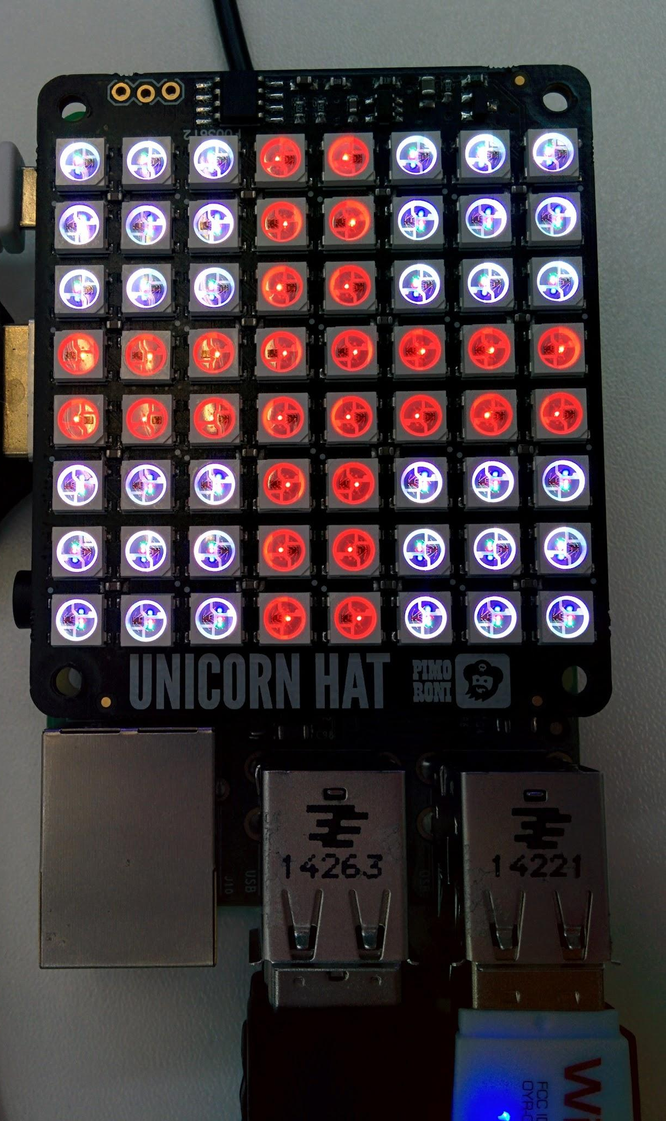
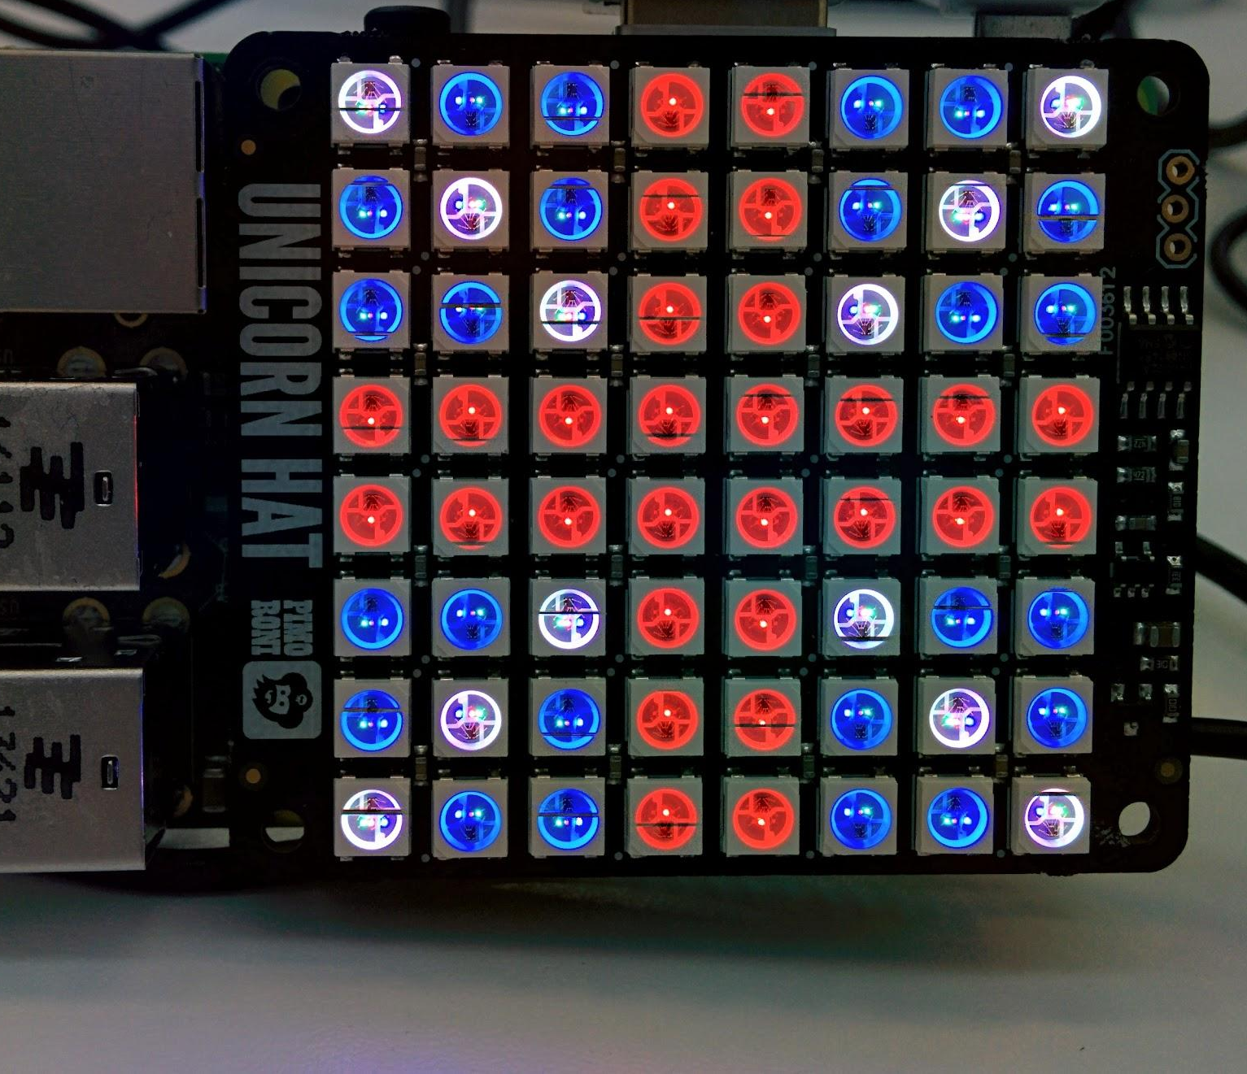
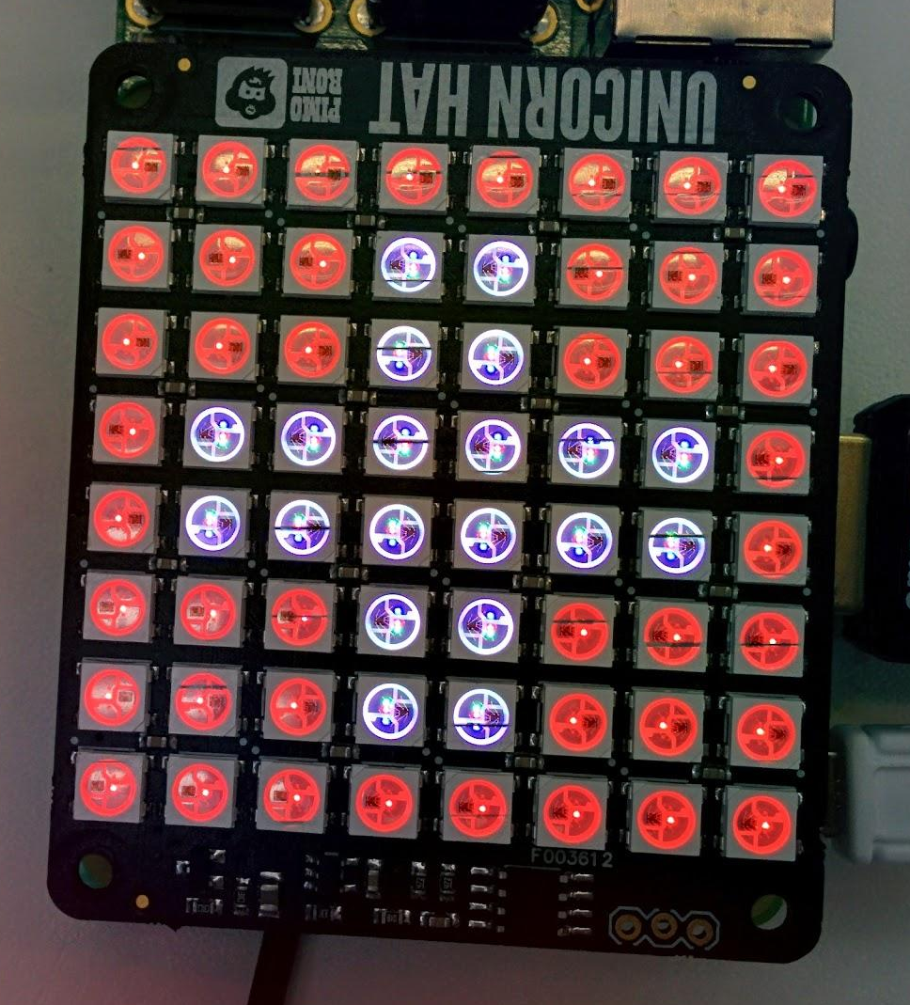
Todays workshop:

Slide 3
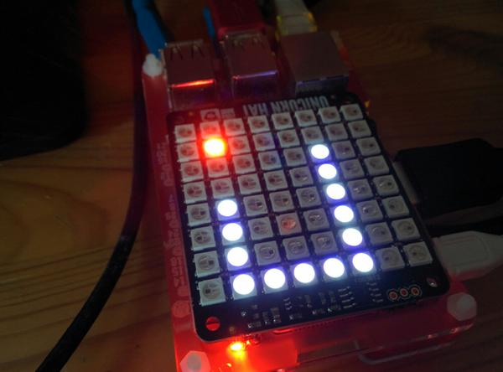
Todays workshop:

Slide 4
Today:
11:00 - Snake workshop
13:00 - Lunch
13:30 - Workshop extensions
WiFi:
SSID MMU-Visitor
Pass. University
Next Month’s Jam:
Saturday 12th September
Slides and other downloads at: bit.ly/McrRaspJam

